Slide 1
Equipment identification through image recognition
Darkhan’s Master thesis
Biweekly report
Literature review

Slide 2
Contents
UDA methods
Unsupervised Domain Adaptative Object Detection
Pseudo-label self training
Image-to-Image translation
Domain randomization
Graph reasoning
Mean teacher training
Adversarial feature learning
Similarity-based Domain Alignment for Adaptive Object Detection, 2021
A Robust Learning Approach to Domain Adaptive Object Detection, 2019
Progressive Domain Adaptation for Object Detection, 2019
A Domain Adaptive Representation Learning Paradigm for Object Detection, 2019
Exploring Object Relation in Mean Teacher for Cross-Domain Detection, 2019
Unsupervised Domain Adaptation of Object Detectors: A Survey, 2021
A Survey of Unsupervised Domain Adaptation for Visual Recognition, 2021
Deep Visual Domain Adaptation: A Survey, 2018
Notes:
Discrepancy-based: these methods minimize the distance between the source domain and the target domain using different statically defined distance functions.
Adversarial-based: these methods identify the domain invariant features via two competing networks.
Pseudo-labeling-based: these methods generate pseudo labels for the target domain to reduce the domain divergence.
Reconstruction-based: these methods map two domains into a shared domain while preserving domain specific features.
Representation-based: these methods utilize the trained network to extract intermediate representations as an input for a new network.
Attention-based: these methods pay attention to regions of interests (ROIs), which maintains shared information of both source domain and the target domain.
In the referenced paper the method https://arxiv.org/pdf/2111.02207.pdf seems to be promising

Slide 3
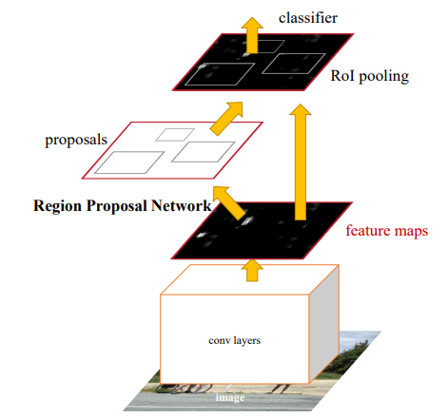
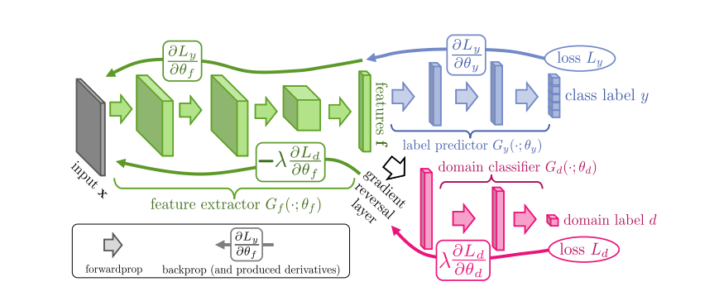
Gradient reversal layer (GRL)
Unsupervised Domain Adaptative Object Detection
Adversarial feature learning
Gradient reversal layer (GRL)
Source: Domain-Adversarial Training of Neural Networks, 2016
Source: Faster R-CNN: Towards Real-Time Object Detection with Region Proposal Networks, 2016
Notes:
As we can notice from H∆H-distance given in Eq. 7, this distance is inversely proportional to the error rate of the domain classifier D.
The goal in a domain adaptation scenario is to reduce this distance, i.e., increase the domain classifier error.
Ganin et al. [23] exploited this and proposed a novel gradient reversal approach to train any neural network model for domain adaptation.
The overall goal is to achieve a domain invariant feature space of a backbone neural network with the help of a neural network-based domain classifier.

Slide 4
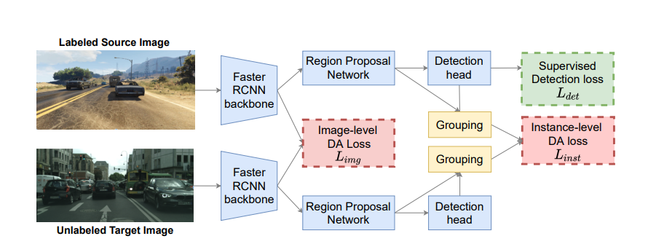
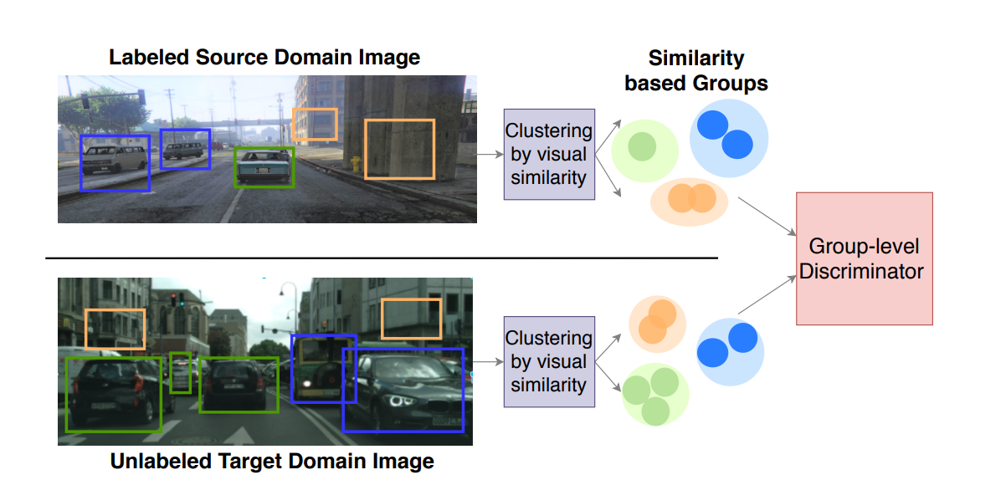
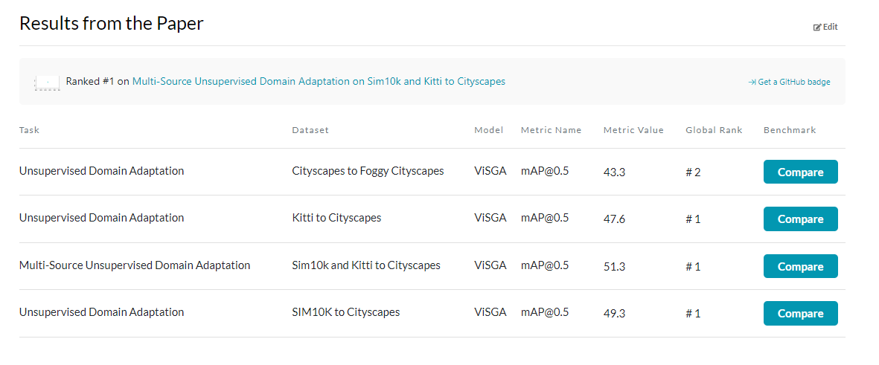
Similarity-based Domain Alignment for Adaptive Object Detection
Unsupervised Domain Adaptative Object Detection
Adversarial feature learning
Similarity-based Domain Alignment for Adaptive Object Detection, 2021
AT vs CL
GRL
Source: VisGA, Similarity-based Domain Alignment for Adaptive Object Detection, 2021
Notes:
Adversarial and contrastive learning
The main idea in max margin contrastive loss is to push features from the same class closer and push apart features belonging to different classes across domains.
(It essentially equates the Euclidean distance between them if they have the same label (y_i=y_j) and is otherwise equivalent to hinge loss)
Starting bottom-up, each proposal is considered as an individual cluster.
Then, at each step, the two closest clusters according to a distance metric are merged together.
We utilize cosine distance as our merging metric:

Slide 5
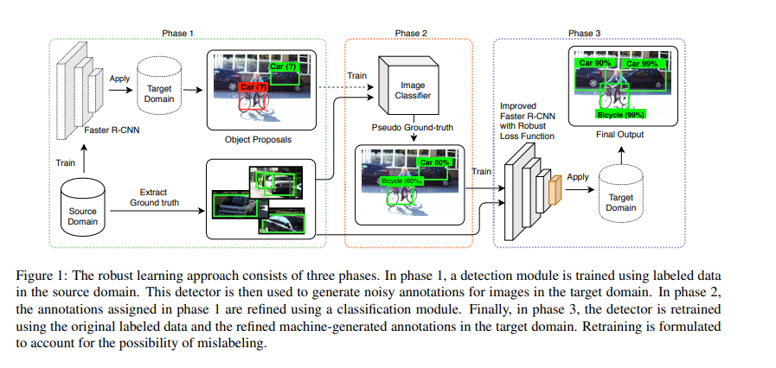
A Robust Learning Approach to Domain Adaptive Object Detection
Unsupervised Domain Adaptative Object Detection
Pseudo labeling based methods
A Robust Learning Approach to Domain Adaptive Object Detection, 2019
Maximum likelihood loss:
Source: A Robust Learning Approach to Domain Adaptive Object Detection, 2019
Notes:
Figure 1: The robust learning approach consists of three phases.
In phase 1, a detection module is trained using labeled data in the source domain.
This detector is then used to generate noisy annotations for images in the target domain.
In phase 2, the annotations assigned in phase 1 are refined using a classification module.
Finally, in phase 3, the detector is retrained using the original labeled data and the refined machine-generated annotations in the target domain.
Retraining is formulated to account for the possibility of mislabeling.
We seek a distribution, q(yc), which is close to both the classification model of Faster R-CNN and the image classification model p img, that is trained in phase two.
The label (yc) and the box location/size (yl)
Kullback-Leibler Divergence
https://machinelearningmastery.com/divergence-between-probability-distributions/
where α is a hyper-parameter that controls the trade-off between the two terms. α starts with a large value and it is gradually decreased to smaller values as the third phase training progresses

Slide 6
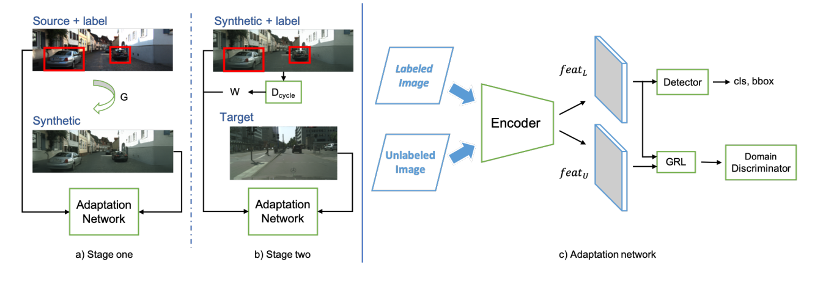
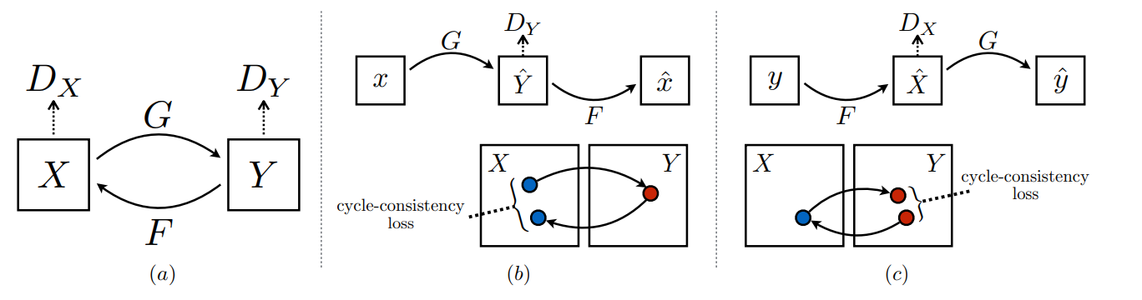
Progressive Domain Adaptation for Object Detection
Unsupervised Domain Adaptative Object Detection
Image to Image translation
Progressive Domain Adaptation for Object Detection, 2019
CycleGAN
Unpaired Image-to-Image Translation using Cycle-Consistent Adversarial Networks , 2017
Source: Progressive Domain Adaptation for Object Detection, 2019
Notes:
The proposed progressive adaptation framework. The algorithm includes two stages of adaptation as shown in a) and b). In a), we first transform source images to generate synthetic ones by using the generator G learned via CycleGAN [36].
Afterward, we use the labeled source domain and perform first stage adaptation to the synthetic domain.
Then in b), our model applies a second stage adaptation which takes the synthetic domain with labels inherited from the source and aligns the synthetic domain features with the target distribution.
In addition, a weight w is obtained from the discriminator Dcycle in CycleGAN to balance the synthetic image qualities in the detection loss.
The overall structure of our adaptation network is shown in c). Labeled and unlabeled images are both passed through the encoder network E to extract CNN features featL and featU .
We then use them to: 1) learn supervised object detection with the detector network from featL, and 2) forward both features to GRL and a domain discriminator, learning domain-invariant features in an adversarial manner.
Cross-entropy loss, or log loss, measures the performance of a classification model whose output is a probability value between 0 and 1. Cross-entropy loss increases as the predicted probability diverges from the actual label.

Slide 7
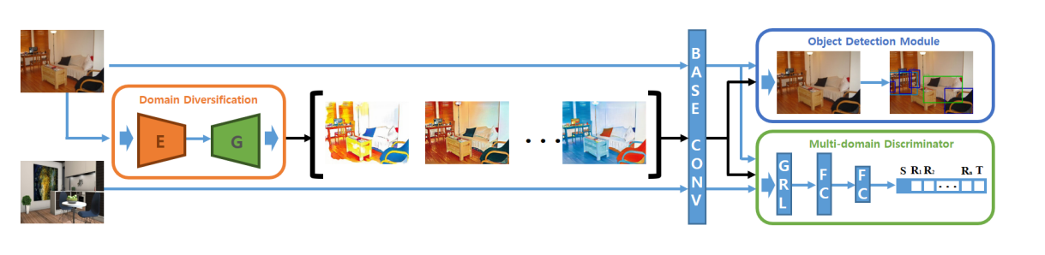
A Domain Adaptive Representation Learning Paradigm for Object Detection
Unsupervised Domain Adaptative Object Detection
Domain randomization
A Domain Adaptive Representation Learning Paradigm for Object Detection, 2019
CycleGAN
Unpaired Image-to-Image Translation using Cycle-Consistent Adversarial Networks , 2017
Source: Diversify and Match: A Domain Adaptive Representation Learning Paradigm, 2019
Notes:
To distinctively shift the source domain, we consider two factors in the objective function, i.e., color preservation and reconstruction.
Color preservation loss (on average the color diversity should be the same)
Inverse translation loss

Slide 8
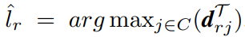
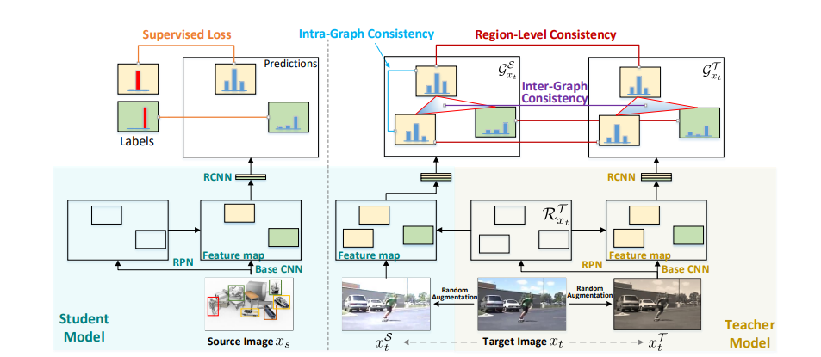
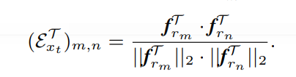
Exploring Object Relation in Mean Teacher for Cross-Domain Detection
Unsupervised Domain Adaptative Object Detection
Mean teacher training + Graph reasoning
Exploring Object Relation in Mean Teacher for Cross-Domain Detection, 2019
Pseudo labels:
Cosine similarity
Source: Exploring Object Relation in Mean Teacher for Cross-Domain Detection, 2019
Notes:
With the inputs of two different augmentations for the same unlabeled sample, teacher and student models should produce similar predicted probabilities.
We are treating each region in teacher/student as one vertex and obtaining the affinity matrix whose entry measures the similarities between every two regions.
three consistency regularizations:
1) region-level consistency to align the region-level predictions of the vertices in teacher and student graphs sharing the same spatial location – Average RMS(E_teach, E_stud)
2) inter-graph consistency for matching the graph structures (i.e., the affinity matrices) of teacher and student graphs – Average RMS(aff_teach, aff_stud)
3) intra-graph consistency to enhance the similarity between regions belonging to the same class within the graph of student.

Slide 9

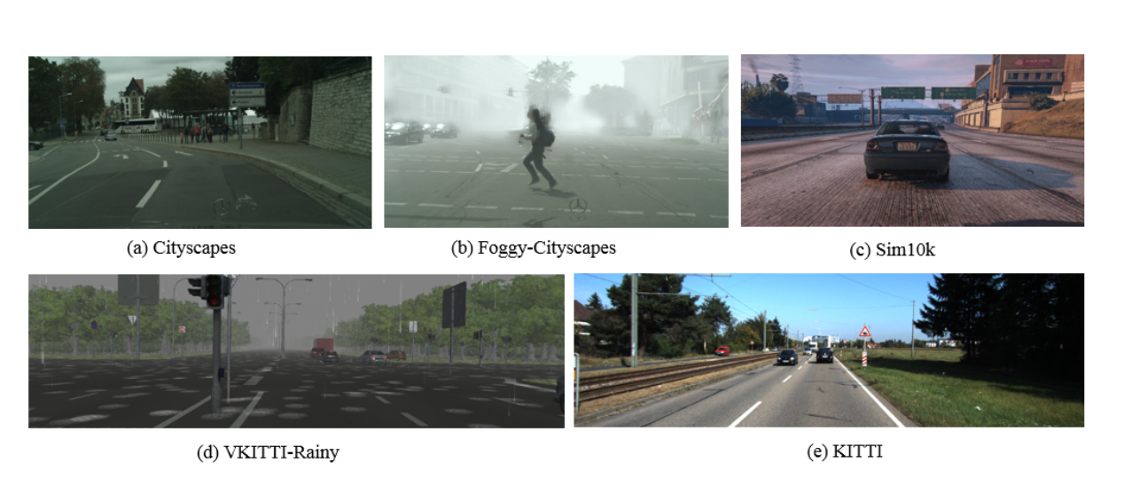
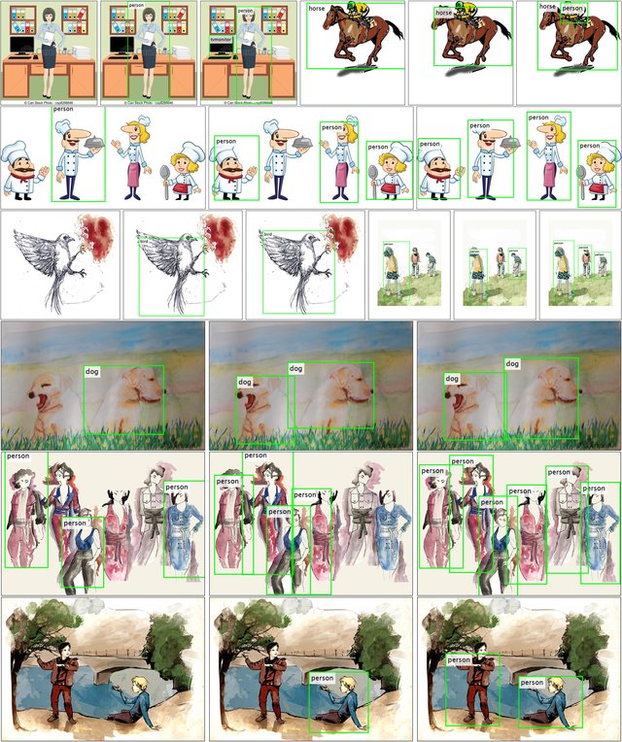
Research directions
Complex real-world datasets and considering other applications
Common applications:
Autonomous driving
Drawings
Day-to-day objects
No industrial applications
Based on: Unsupervised Domain Adaptation of Object Detectors: A Survey, 2021

Slide 10
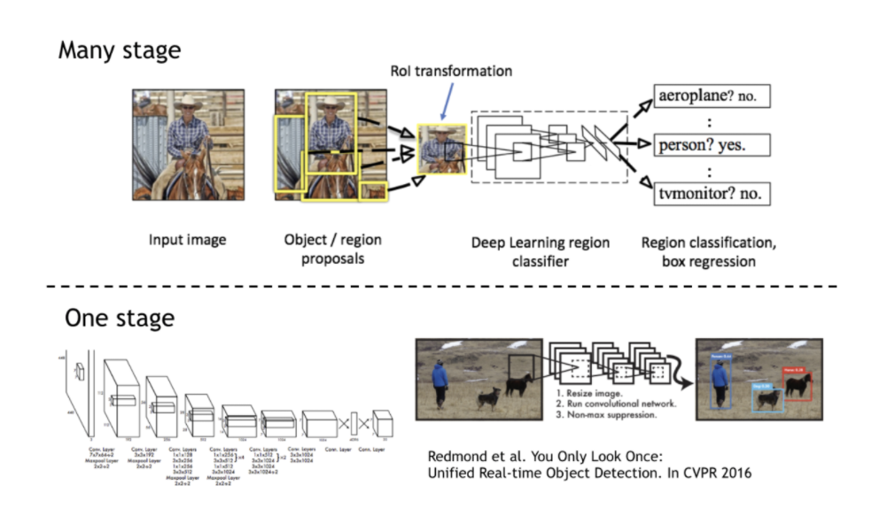
Research directions
Generalizing to other detection frameworks
Object detection frameworks
Two-stage detectors
One-stage detectors
Faster RCNN (2015)
Mask R-CNN (2017)
SSD (2016)
YOLOR (2021)
FCOS
DETR
YOLO:
Domain Adaptive YOLO for One-Stage Cross-Domain Detection, 2021
Multiscale domain adaptive yolo for cross-domain object detection, 2022
FCOS: Attention-based Domain Adaptation for Single Stage Detectors, 2021
DETR: DA-DETR: Domain Adaptive Detection Transformer by Hybrid Attention
Based on: Unsupervised Domain Adaptation of Object Detectors: A Survey, 2021

Slide 11
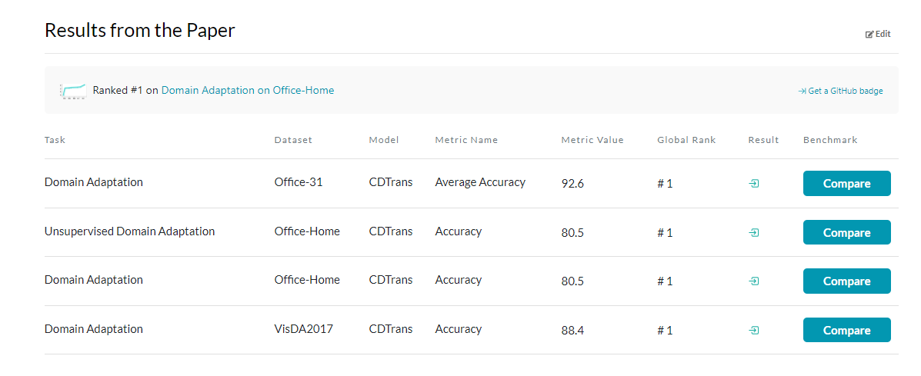
Research directions
Domain adaptation in image classifiers
DA in classification problems:
CDTrans: Cross-domain Transformer for Unsupervised Domain Adaptation, 2022
Implicit Class-Conditioned Domain Alignment for Unsupervised Domain Adaptation, 2020
FixBi: Bridging Domain Spaces for Unsupervised Domain Adaptation, 2021
On Evolving Attention Towards Domain Adaptation, 2021
Domain generalization:
Domain Generalization by Mutual-Information Regularization with Pre-trained Models, 2022
Motivation:

Slide 12
Research directions
Others
Weak/semi-supervised domain adaptation
Leverage from annotations for a smaller subset of images in a target dataset
Imbalanced classes
To develop methods that estimate the class distribution in the target dataset and reevaluate the weights
Partial domain adaptation
Target dataset has fewer classes than the ones in the source dataset
Open-set domain adaptation
Target domain contains unknown classes that are not observed in the source domain
Source-free domain adaptation
Source dataset is not available, but the model is
Multi-source domain adaptation (N/A)
Continuous and test time adaptation
Gradually changing lighting/weather conditions
Based on: Unsupervised Domain Adaptation of Object Detectors: A Survey, 2021

Slide 13
Other promising papers to consider
Domain adaptation of object detectors
By absolute mAP:
By ∆mAP:
Alternatives: Self-Adversarial Disentangling for Specific Domain Adaptation
Method | CS → F | S10K → CS | KI → CS | CS → KI | VOC → Clip | VOC → WC | VOC → Comic | CS → BDD | Framework | LR | Additional Comments | Average | Datasets tested | Method type
Memory-guided category-wise adaptation 2021 | 41.8 | 44.8 | 43 | 75.5 | - | - | - | - | FRCNN | 0.002 | SS: 600, Epochs: 10 | 51.275 | 4 | Adv.
Spatial attention pyramid network 2020 | 40.9 | 44.9 | 43.4 | 75.2 | 42.2 | 55.2 | - | - | FRCNN | 0.00001 | SS: 600, Iter: 90K | 50.3 | 6 | Adv.
Robust learning from noisy labels 2020 | 36.4 | 42.5 | 42.9 | 77.6 | - | - | - | - | FRCNN | 0.001 | SS: 600 | 49.85 | 4 | Pseudo.
Adaptive transformer-based detector 2021 | 43.5 | 55.3 | - | - | - | - | - | - | DETR | 0.0002 | Epochs: 50 | 49.4 | 2 | Adv.A
Method | CS → F | S10K → CS | KI → CS | CS → KI | VOC → Clip | VOC → WC | VOC → Comic | CS → BDD | Framework | LR | Additional Comments | Average ∆ | Datasets tested | Method type
Every pixel matters 2020 | 17.2 | 18.9 | 13 | - | - | - | - | - | FCOS | 0.005 | SS: 800, Epochs: 10 | 16.36667 | 3 | Adv.
Memory-guided category-wise adaptation 2021 | 17.4 | 10.5 | 12.8 | 22 | - | - | - | - | FRCNN | 0.002 | SS: 600, Epochs: 10 | 15.675 | 4 | Adv.
Spatial attention pyramid network 2020 | 17.6 | 10.3 | 13.2 | 21.7 | 14.4 | 10.6 | - | - | FRCNN | 0.00001 | SS: 600, Iter: 90K | 14.63333 | 6 | Adv.
Based on: Unsupervised Domain Adaptation of Object Detectors: A Survey, 2021

Slide 15
Categorization of Domain Adaptation
Definition: Two domains can be different if at least one of input space, output space, or the probability density function changes between domains
Category gap
Domain shift
Closed set domain adaptation
Open set domain adaptation
Partial domain adaptation
Universal domain adaptation
Prior shift
Covariate shift
Concept shift
Source: A brief review of domain adaptation, 2020
Papers: https://paperswithcode.com/task/domain-adaptation
Notes:
Category gap
Closed set domain adaptation refers to the situation where both source and target domains share the same classes while there still exists a domain gap between domains. Traditional domain adaptation falls into this category
In open set domain adaptation, related domains share some labels in the common label set and also they may have private labels [20]. Saito et al. [21], introduced new open set domain adaptation in which the data in the source private classes is removed. In the modified open set, the source label set is considered to be a subset of the target label set. Open set domain adaptation is suitable when there are multiple source domains where each includes a subset of target classes. Domain adaptation techniques aim to utilize all the source domain information contained in the shared classes to boost the model’s performance in the target domain.
In contrast to open set, partial domain adaptation refers to the situation where the target label set is a subset of the source label set [22], [23]. In this setting, the available source domain can be considered as a generic domain that consists of an abundant number of classes, and the target is only a subset of the source label set with fewer classes.
Universal domain adaptation (UDA) [24], generalizes the above scenarios. In contrast to the above settings, which require prior knowledge about the source and target label sets, universal domain adaptation is not 3 restricted to any prior knowledge. In this setting, source and target domains may share common label sets, and also each domain may have a private label set or outlier classes. Universal domain adaptation first tends to find the shared label space across domains and then similar to open set, and partial domain adaptation aligns the data distributions in the common label set. Ultimately, a classifier will be trained on the matched source labeled data to be applied safely to the unlabeled target data. In the testing phase, the trained classifier in both open set and universal domain adaptation is expected to assign accurate labels to the target samples belonging to the shared label space, and mark the samples in the outlier classes as unknown.
Domain shift
Prior shift or class imbalance considers the situation where posterior distributions are equivalent, ps(y|x) = pt(y|x), and prior distributions of classes are different between domains, ps(y) 6= pt(y). To solve a domain adaptation problem with a prior shift, we need labeled data in both source and target domains.
Covariate shift refers to a situation where marginal probability distributions differ, ps(x) 6= pt(x), while conditional probability distributions remain constant across domains, ps(y|x) = pt(y|x). Sample selection bias and missing data are two causes for the covariate shift. Most of the proposed domain adaptation techniques aim to solve this class of domain gap.
Concept shift, also known as data drift, is a scenario where data distributions remain unchanged, ps(x) = pt(x), while conditional distributions differ between domains, px(y|x) 6= pt(y|x). Concept shift also requires labeled data in both domains to estimate the ratio of conditional distributions.

Slide 16
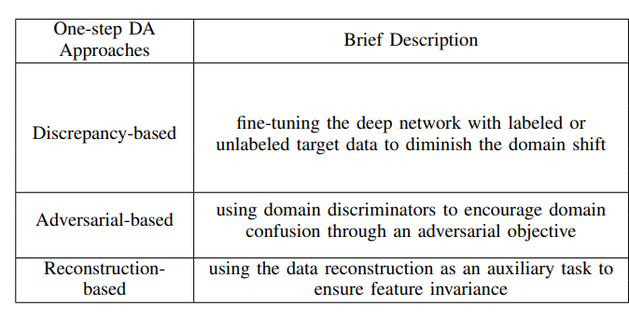
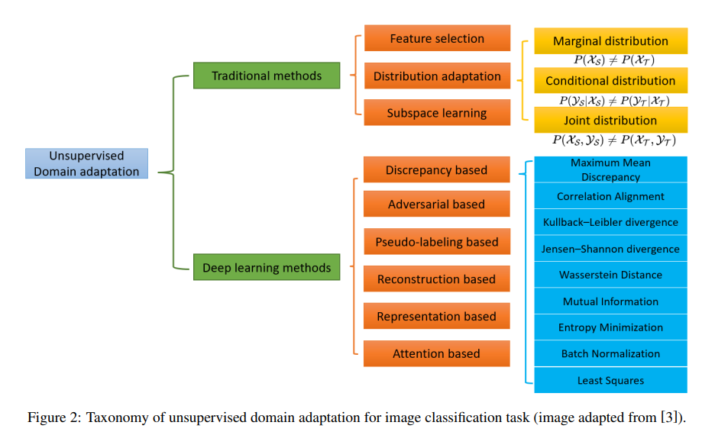
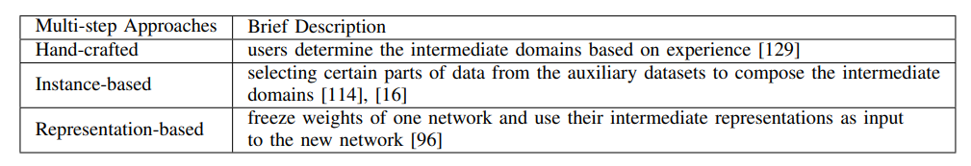
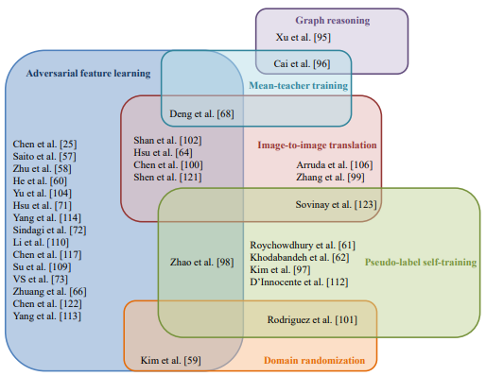
UDA methods
Categories
Deep Visual Domain Adaptation: A Survey, 2018
A Survey of Unsupervised Domain Adaptation for Visual Recognition, 2021
Unsupervised Domain Adaptation of Object Detectors: A Survey, 2021
Notes:
Discrepancy-based: these methods minimize the distance between the source domain and the target domain using different statically defined distance functions.
Adversarial-based: these methods identify the domain invariant features via two competing networks.
Pseudo-labeling-based: these methods generate pseudo labels for the target domain to reduce the domain divergence.
Reconstruction-based: these methods map two domains into a shared domain while preserving domain specific features.
Representation-based: these methods utilize the trained network to extract intermediate representations as an input for a new network.
Attention-based: these methods pay attention to regions of interests (ROIs), which maintains shared information of both source domain and the target domain.
In the referenced paper the method https://arxiv.org/pdf/2111.02207.pdf seems to be promising

Slide 17
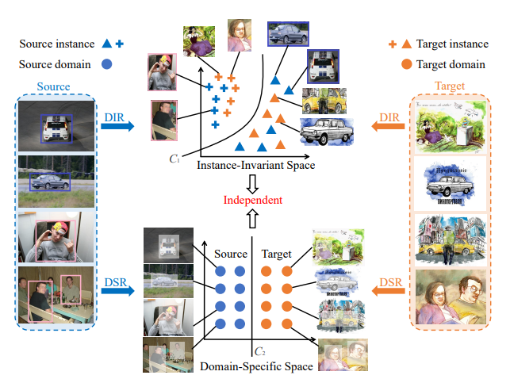
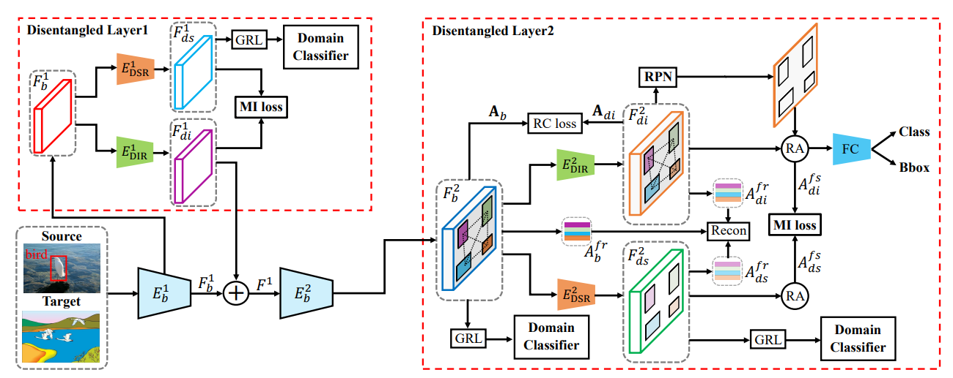
Graph reasoning
Instance-Invariant Domain Adaptive Object Detection via Progressive Disentanglement
Source: Instance-Invariant Domain Adaptive Object Detection via Progressive Disentanglement, 2021

Slide 18
Surveys on domain adaptation
http://www.whdeng.cn/papers/18_Wang_Deng_DA_Survey.pdf
https://engineering.jhu.edu/vpatel36/wp-content/uploads/2018/08/SPM_DA_v9.pdf
https://arxiv.org/pdf/1802.03601.pdf
https://arxiv.org/pdf/2112.06745.pdf

Slide 19
Types of methods to tackle domain adaptation
https://arxiv.org/pdf/1905.07720v3.pdf
Integral probability metrics
Adversarial training / Adversarial feature learning
Pseudo labeling / Pseudo-label based self-training
https://arxiv.org/pdf/2105.13502.pdf
Image-to-image translation
Domain randomization
Mean-teacher training
Graph reasoning

Slide 20
Discrepancy based approach
Class criterion
Train a base network with source data
Reuse the first n layers to conduct a target network
The remaining layers of the target network are randomly initialized and trained with loss based on discrepancy.
During training, the first n layers of the target network can be fine-tuned or frozen depending on the size of the target dataset and its similarity to the source dataset
If there is no target labels → pseudo-labeling method
Deep Visual Domain Adaptation: A Survey, 2018
Notes:
marginal and the conditional distributions

